Slide 1

ArchiCraft Engineering.
CONSTRUCTION SERVICES ..CREATIVE & PROFESSIONAL

Slide 2
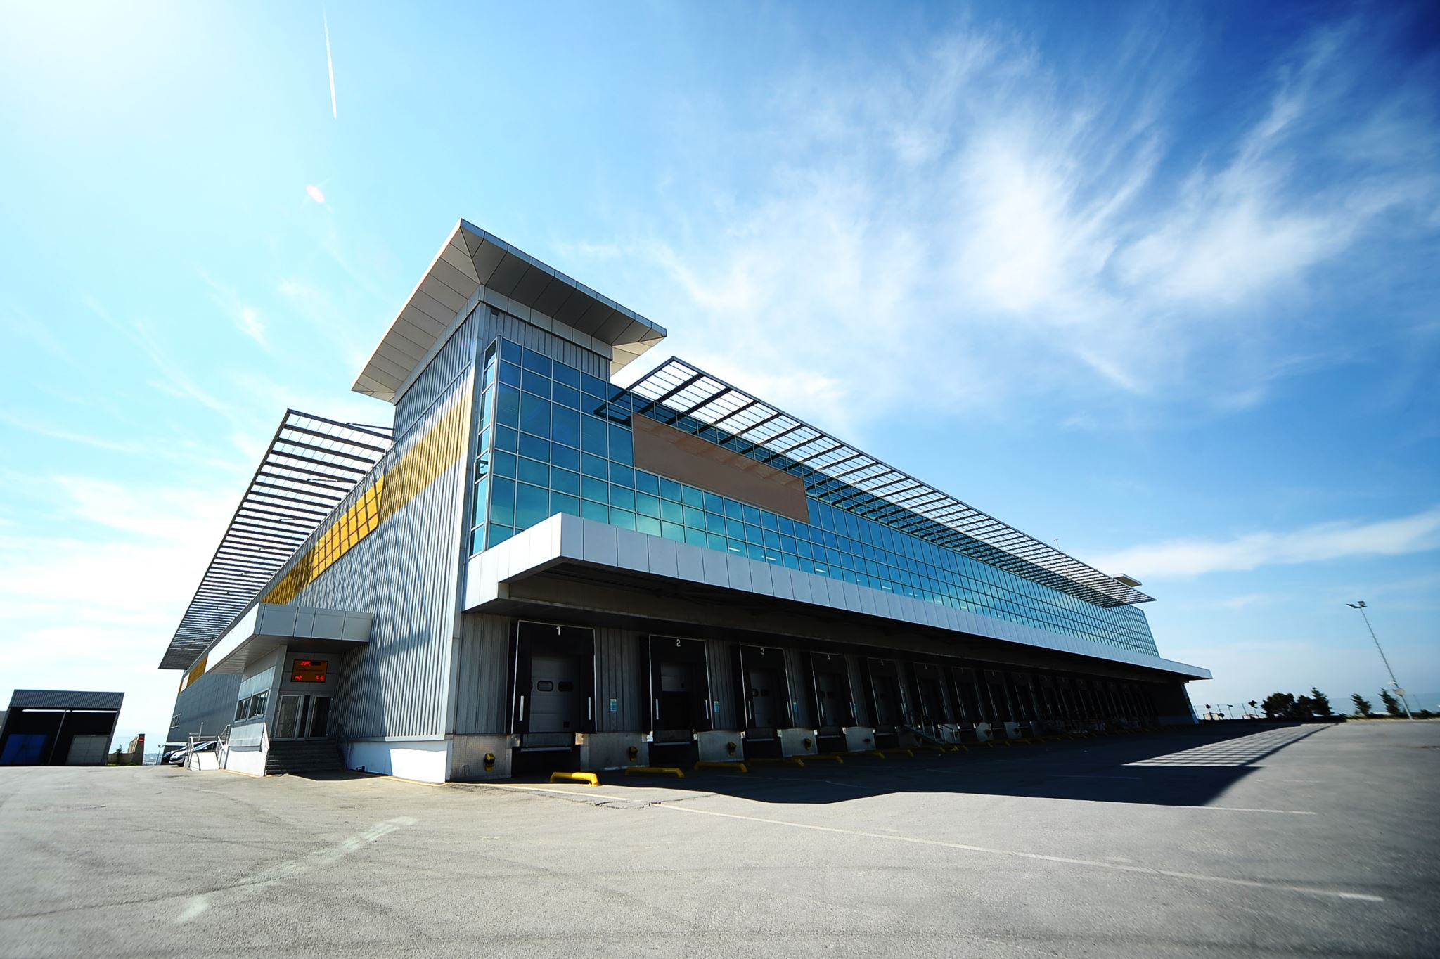
About ArchiCraf Engineering
ArchiCraft Engineering is a leading engineering company specializing in designing and building stunning houses and palaces. With years of experience in the industry, we understand the importance of meticulous planning, aesthetic appeal, and unparalleled quality.

Slide 3

OUR SERVICES
1. Building Design and Engineering

Slide 4
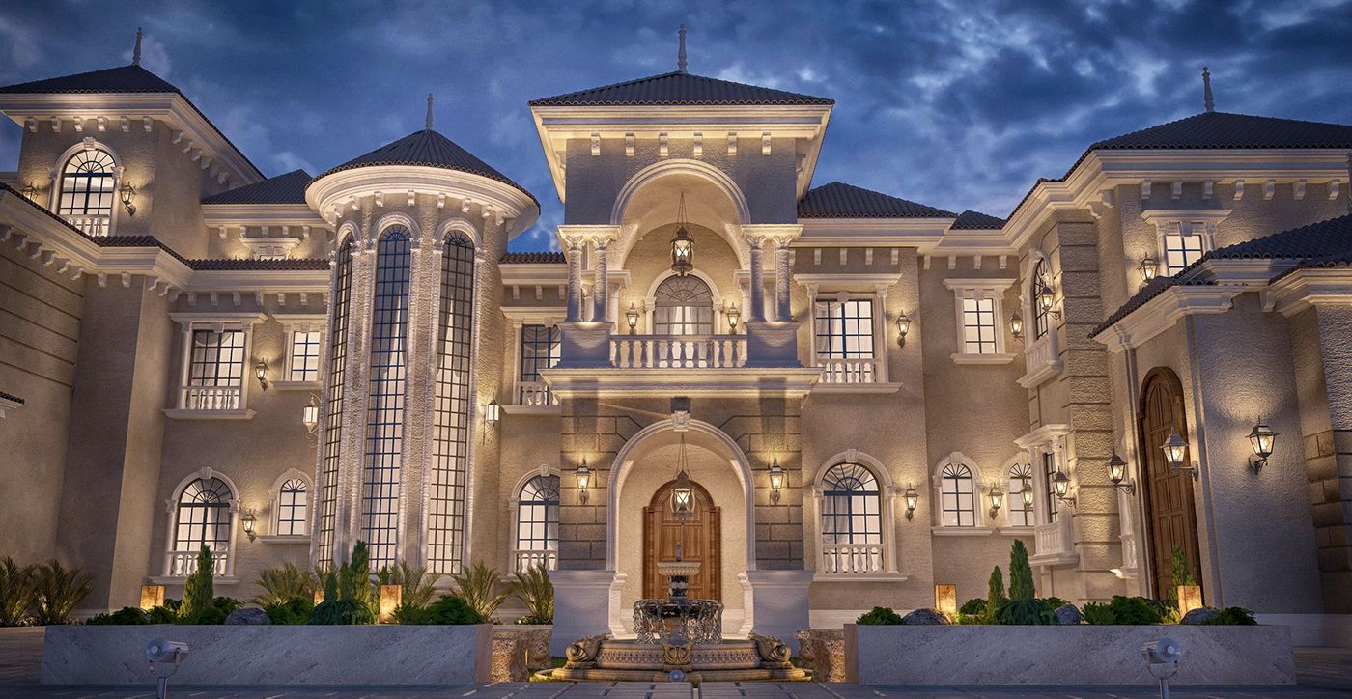
2.Palace Design and Engineering

Slide 5

3.Construction Management

Slide 6
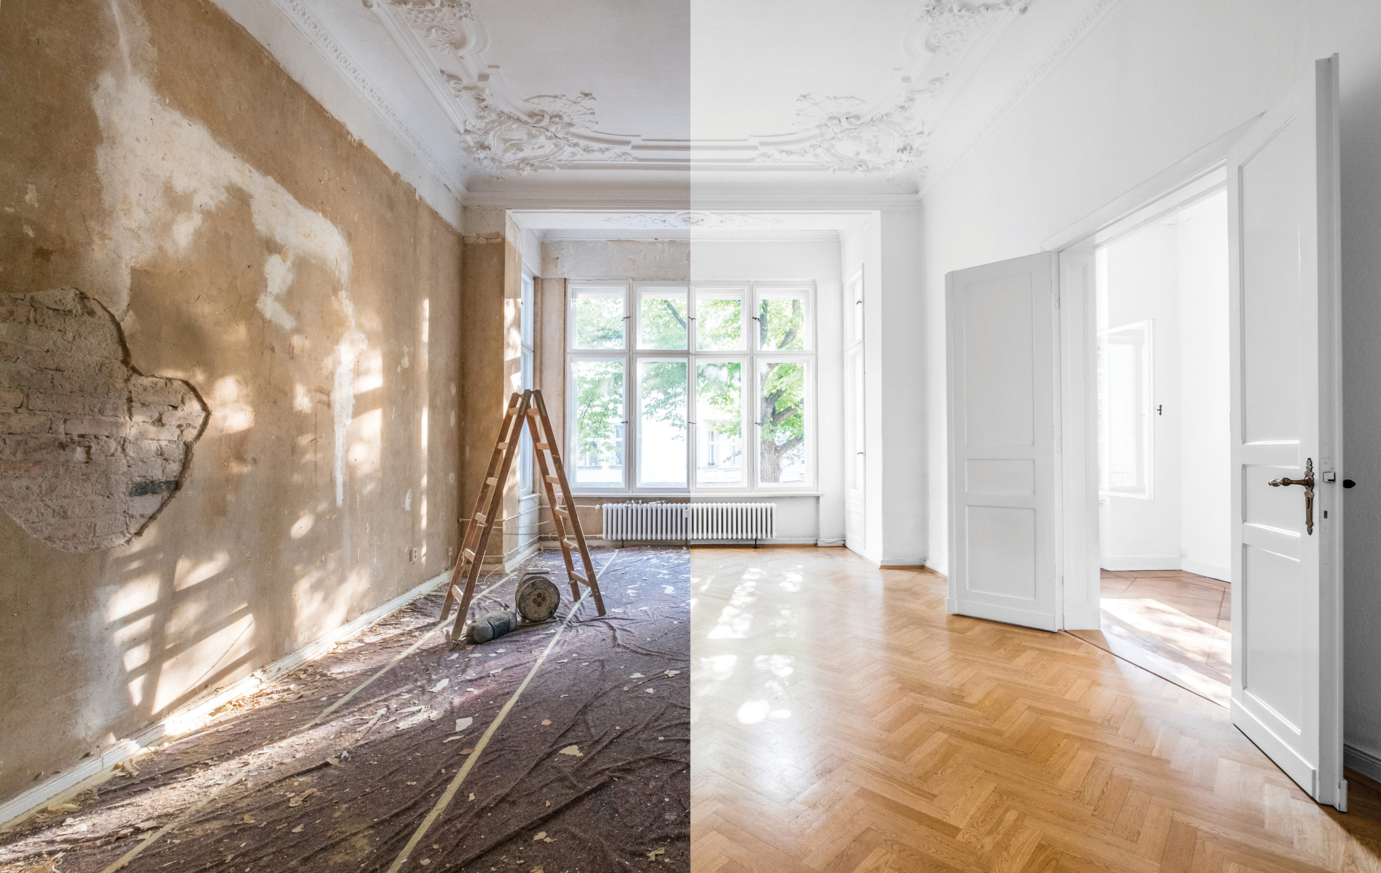
4. Renovation and Restoration

Slide 7

5.Sustainability Solutions

Slide 8

Technology used

Slide 9

Front end
Html
Css
JavaScript
Input validation
Friendly interface

Slide 10

Backend
mysql
php
xampp
Logging service
Database
Authentication

Slide 11
.
TeamGantt
Draw.io
Edraw
For diagram creation and work management.
Microsoft word
For documentation.

Slide 12
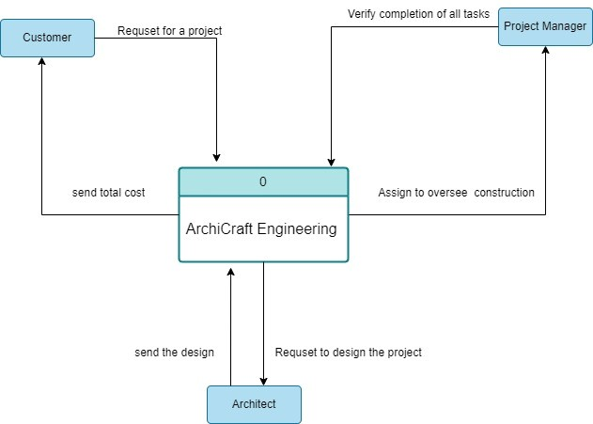
Context Diagram:

Slide 13
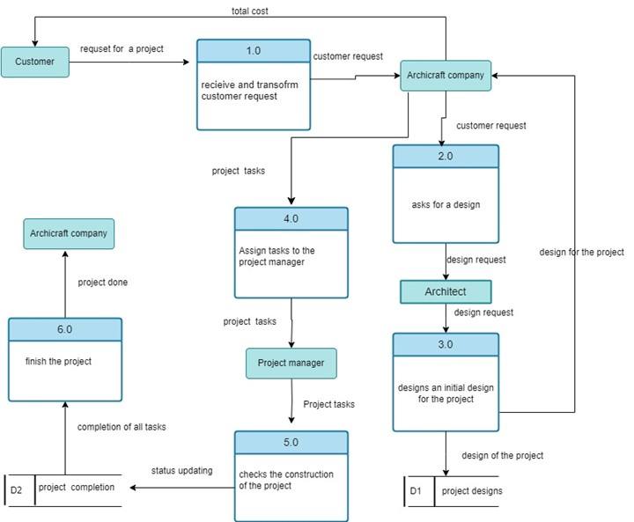
Data flow diagram:

Slide 14
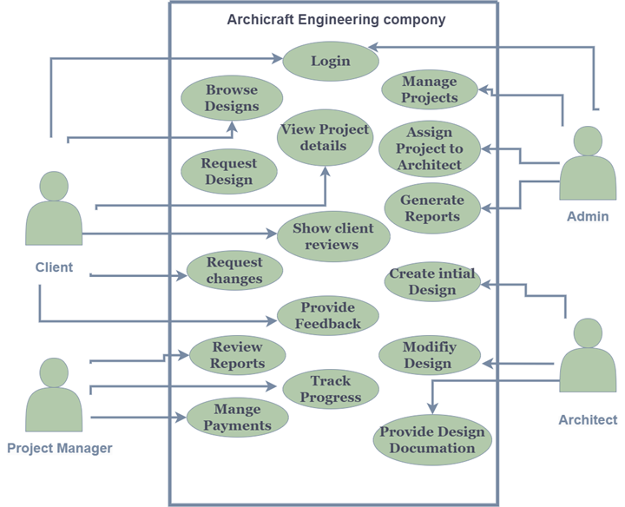
Use case diagram:

Slide 15
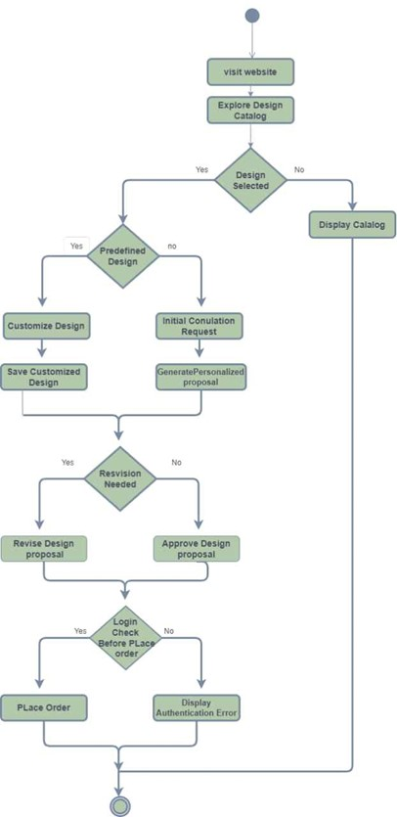
Activity diagram

Slide 16
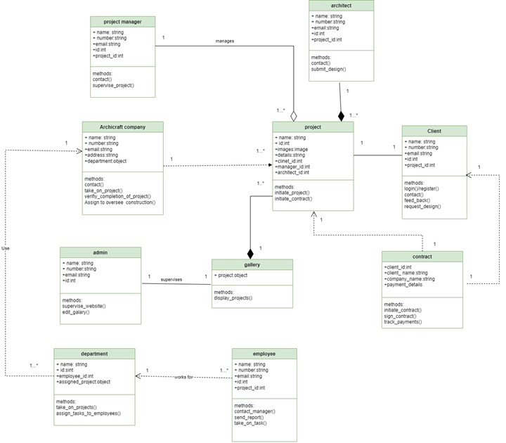
Class diagram

Slide 17
Project by
Heba Maher
Nourhan Ayman
Heba Adel

Slide 18


Thank you

